Slide 1
Glide & Data Driven Views

Slide 2
Glide

Slide 3
Glide
Glide is a fast and efficient open source media management and image loading framework for Android that wraps media decoding, memory and disk caching, and resource pooling into a simple and easy to use interface.
https://github.com/bumptech/glide

Slide 4
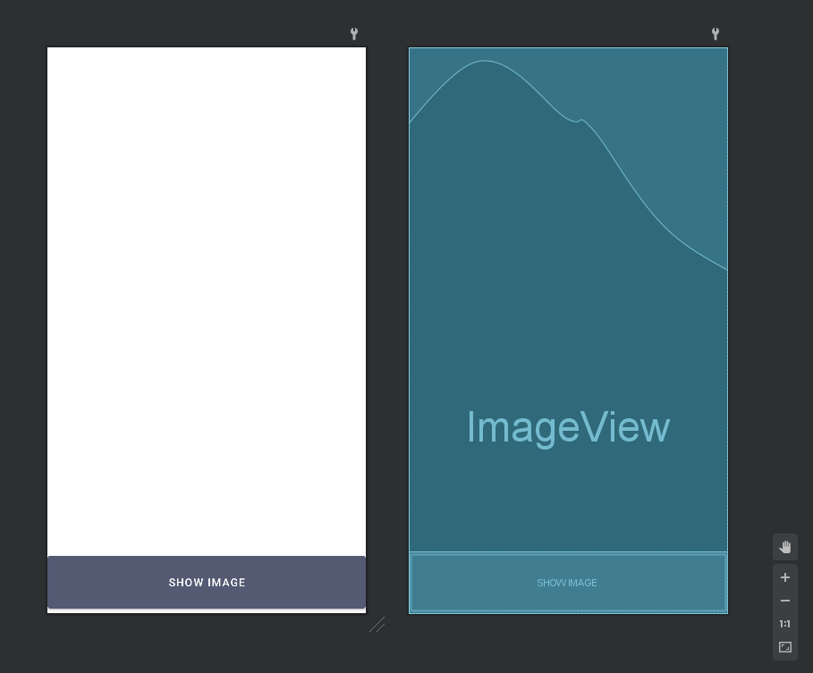
Glide - Design

Slide 5

Glide - Basic Usage
loadImage(){
String imageUrl = "https://m.media-amazon.com/images/M/MV5BMDFkYTc0MGEtZmNhMC00ZDIzLWFmNTEtODM1ZmRlYWMwMWFmXkEyXkFqcGdeQXVyMTMxODk2OTU@._V1_Ratio0.6716_AL_.jpg";
Glide.with(this) .load(imageUrl) .into(activityGlideBinding.actionImage); }

Slide 6
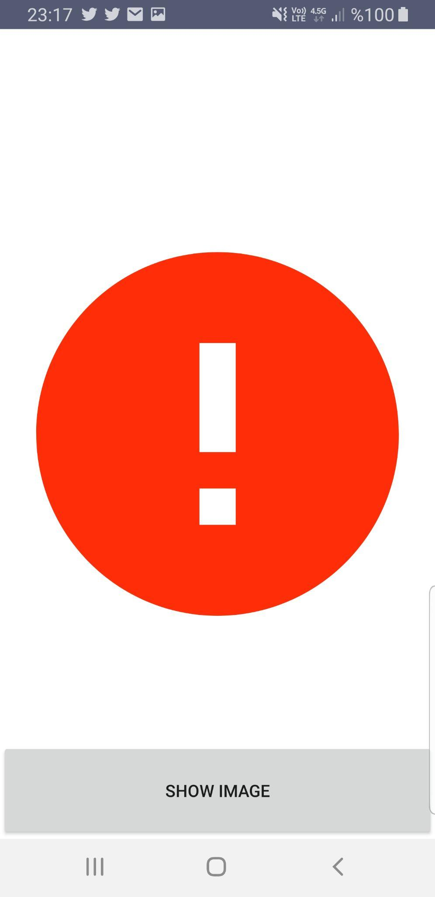
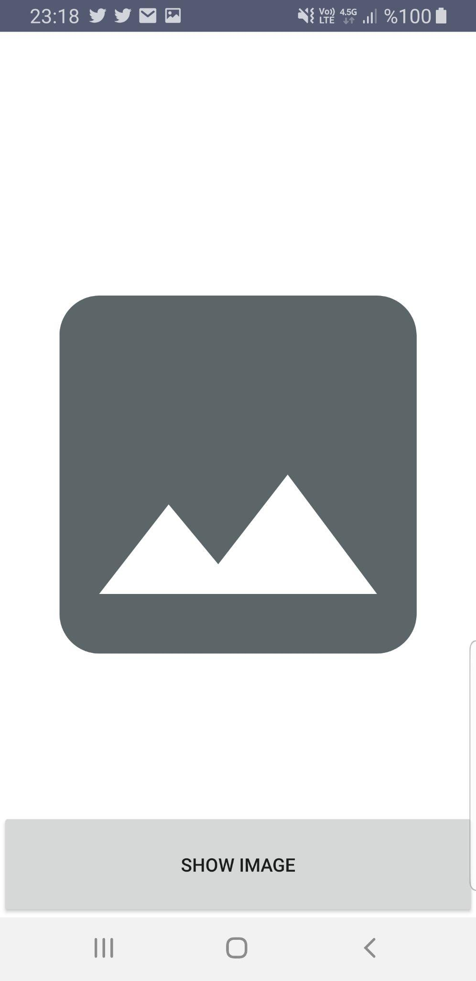
Glide - Advanced Usage
loadImage(){
String imageUrl = "https://m.media-amazon.com/images/M/MV5BMDFkYTc0MGEtZmNhMC00ZDIzLWFmNTEtODM1ZmRlYWMwMWFmXkEyXkFqcGdeQXVyMTMxODk2OTU@._V1_Ratio0.6716_AL_.jpg";
Glide.with(this) .load(imageUrl) .placeholder(R.drawable.image_place_holder) .error(R.drawable.image_error) .into(activityGlideBinding.actionImage); }

Slide 7

Glide - Advanced Usage - Resize
loadImage(){
String imageUrl = "https://m.media-amazon.com/images/M/MV5BMDFkYTc0MGEtZmNhMC00ZDIzLWFmNTEtODM1ZmRlYWMwMWFmXkEyXkFqcGdeQXVyMTMxODk2OTU@._V1_Ratio0.6716_AL_.jpg";
Glide.with(this) .load(imageUrl) .centerCrop() .into(activityGlideBinding.actionImage); }

Slide 8

Glide - Advanced Usage - Resize
loadImage(){
String imageUrl = "https://m.media-amazon.com/images/M/MV5BMDFkYTc0MGEtZmNhMC00ZDIzLWFmNTEtODM1ZmRlYWMwMWFmXkEyXkFqcGdeQXVyMTMxODk2OTU@._V1_Ratio0.6716_AL_.jpg";
Glide.with(this) .load(imageUrl) .override(300, 200) // scale to fill the ImageView and crop any extra .into(activityGlideBinding.actionImage); }

Slide 9
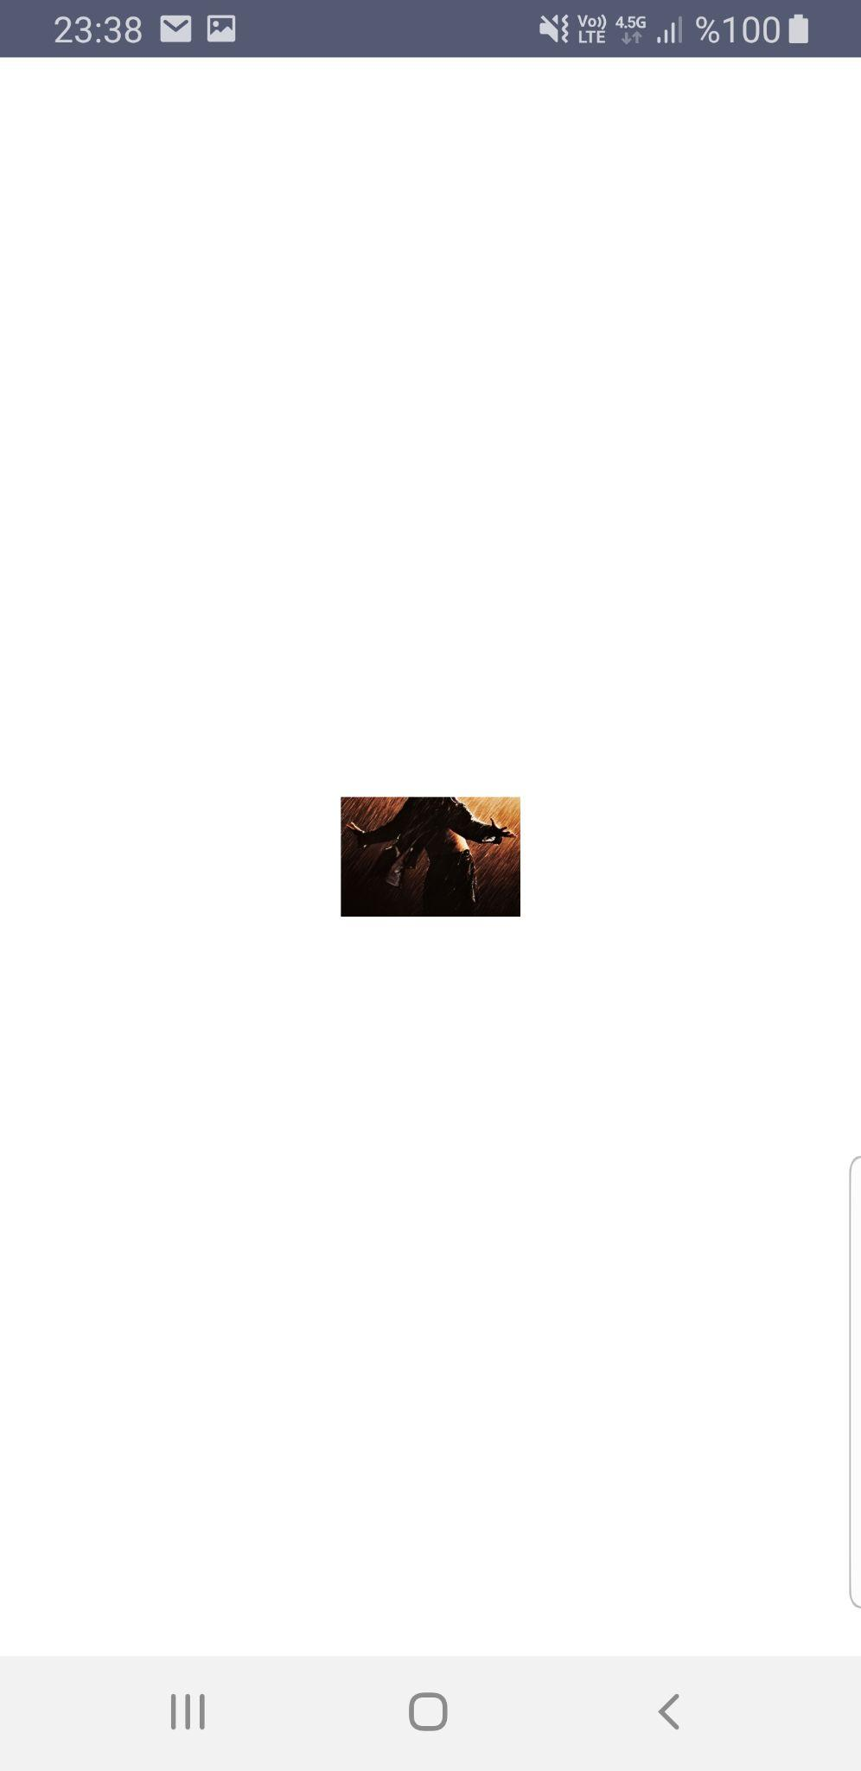
Glide - Advanced Usage - Resize
loadImage(){
String imageUrl = "https://m.media-amazon.com/images/M/MV5BMDFkYTc0MGEtZmNhMC00ZDIzLWFmNTEtODM1ZmRlYWMwMWFmXkEyXkFqcGdeQXVyMTMxODk2OTU@._V1_Ratio0.6716_AL_.jpg";
Glide.with(this) .load(imageUrl) .override(300, 200) // scale to fill the ImageView and crop any extra .into(activityGlideBinding.actionImage); }

Slide 10
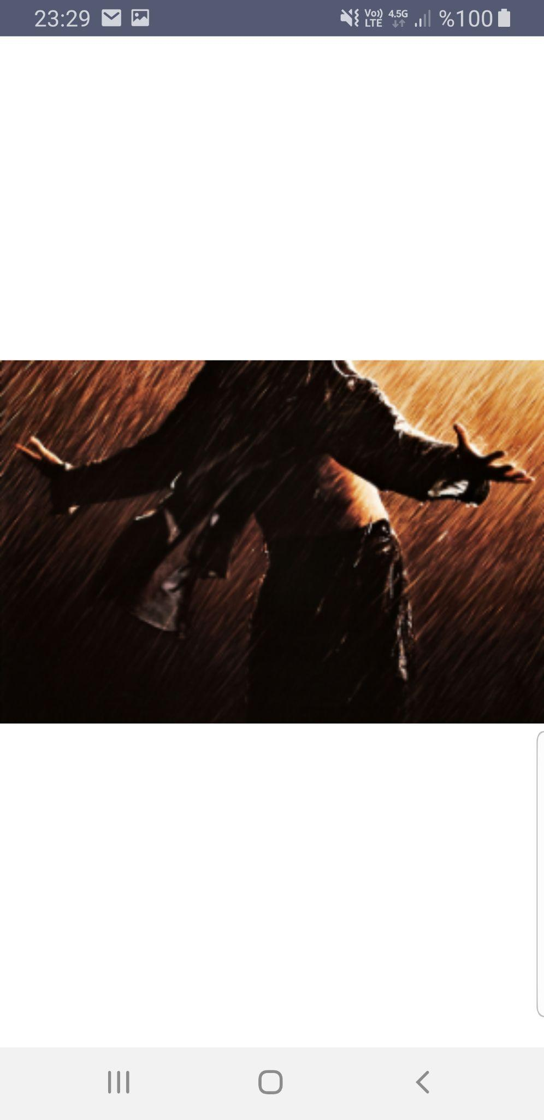
Glide - Advanced Usage - Resize
loadImage(){
String imageUrl = "https://m.media-amazon.com/images/M/MV5BMDFkYTc0MGEtZmNhMC00ZDIzLWFmNTEtODM1ZmRlYWMwMWFmXkEyXkFqcGdeQXVyMTMxODk2OTU@._V1_Ratio0.6716_AL_.jpg";
Glide.with(this) .load(imageUrl) .centerCrop() .override(300, 200) // scale to fill the ImageView and crop any extra .into(activityGlideBinding.actionImage); }

Slide 11

Glide - Advanced Usage - Resize
loadImage(){
String imageUrl = "https://m.media-amazon.com/images/M/MV5BMDFkYTc0MGEtZmNhMC00ZDIzLWFmNTEtODM1ZmRlYWMwMWFmXkEyXkFqcGdeQXVyMTMxODk2OTU@._V1_Ratio0.6716_AL_.jpg";
Glide.with(this) .load(imageUrl) .centerCrop() .override(300, Target.SIZE_ORIGINAL) .into(activityGlideBinding.actionImage); }

Slide 12
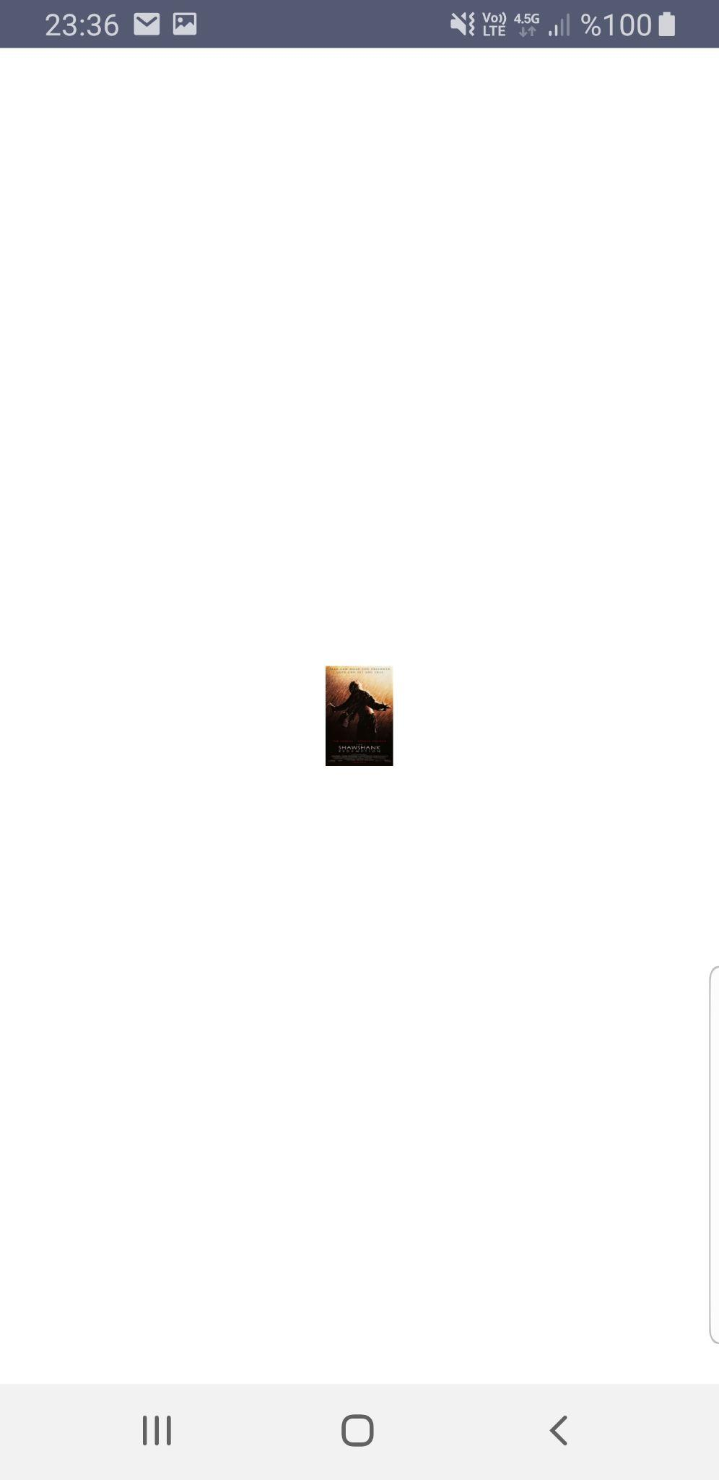
Glide - Advanced Usage - Resize
loadImage(){
String imageUrl = "https://m.media-amazon.com/images/M/MV5BMDFkYTc0MGEtZmNhMC00ZDIzLWFmNTEtODM1ZmRlYWMwMWFmXkEyXkFqcGdeQXVyMTMxODk2OTU@._V1_Ratio0.6716_AL_.jpg";
Glide.with(this) .load(imageUrl) .override(300, 200) // resizes the image to 300x200 pixels but does not respect aspect ratio .fitCenter() .into(activityGlideBinding.actionImage); }

Slide 13
Glide - Advanced Usage - OkHttp
loadImage(){ Glide.with(this) .load(imageUrl) .fitCenter() .placeholder(R.drawable.image_place_holder) .error(R.drawable.image_error) .listener(new RequestListener<Drawable>() { @Override public boolean onLoadFailed(@Nullable GlideException e, Object model, Target<Drawable> target, boolean isFirstResource) { // log exception Log.e("TAG", "Error loading image", e); return false; // important to return false so the error placeholder can be placed } @Override public boolean onResourceReady(Drawable resource, Object model, Target<Drawable> target, DataSource dataSource, boolean isFirstResource) { return false; } }) .into(activityGlideBinding.actionImage); }

Slide 14
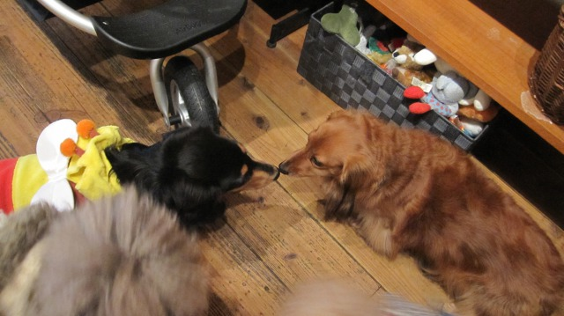
Glide-transformations
https://github.com/wasabeef/glide-transformations/blob/main/README.md#transformations-1

Slide 15
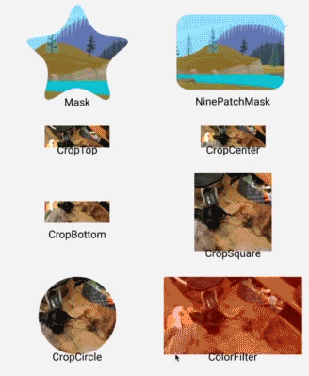
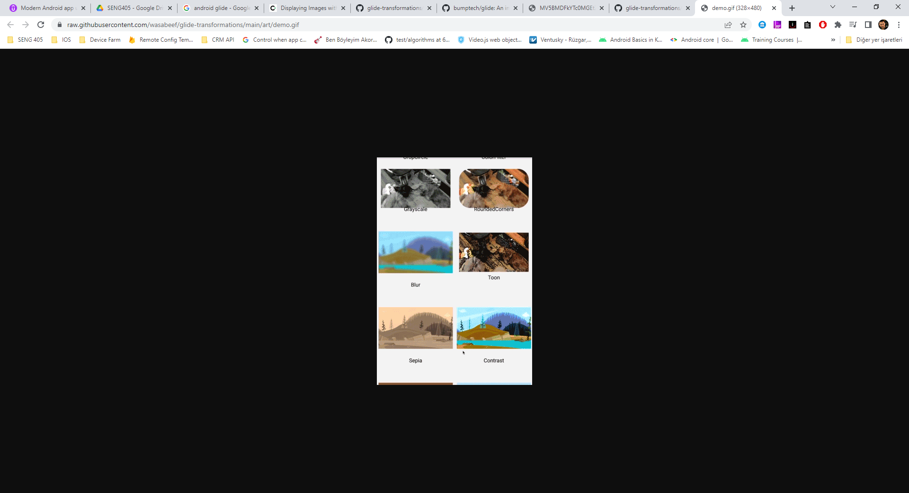
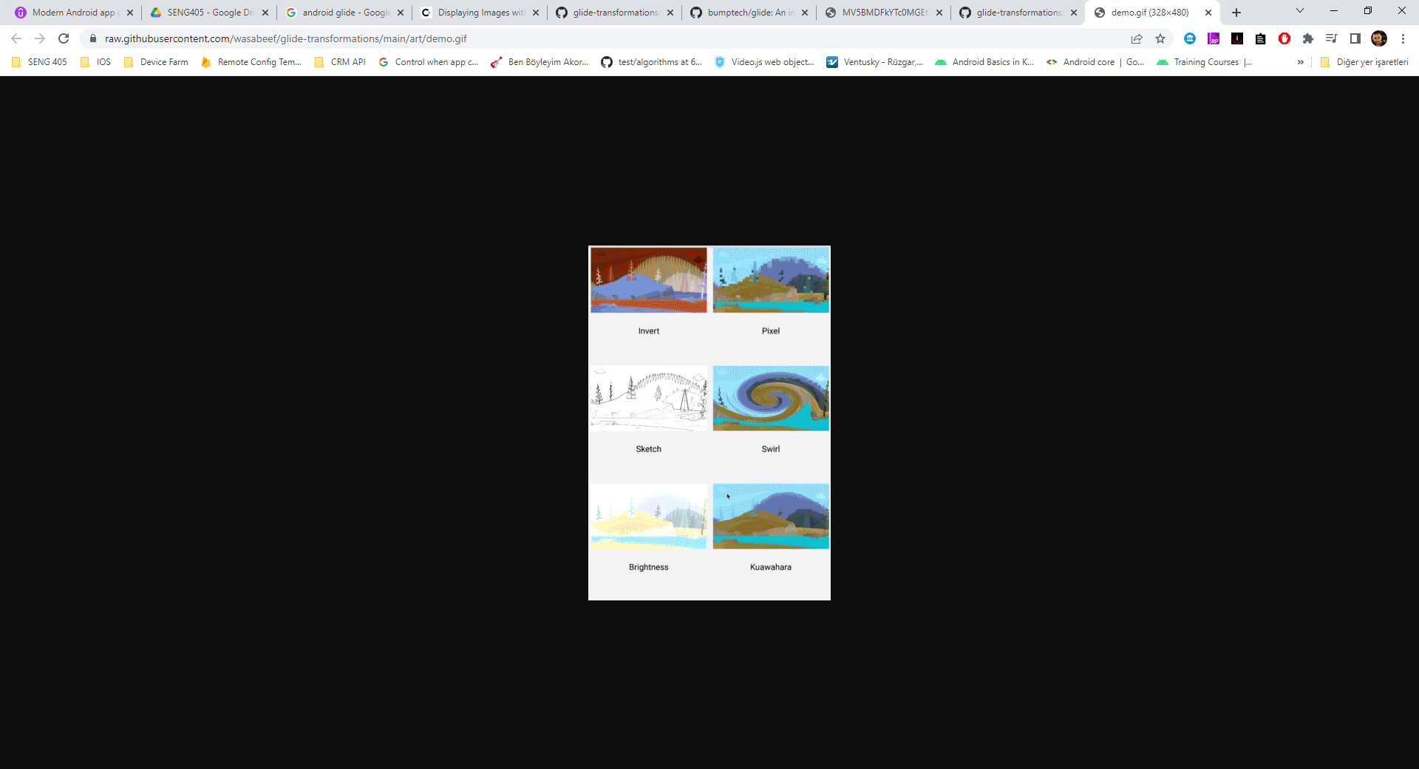
Glide-transformations

Slide 16
Data Driven Views
Listview - Recyclerview

Slide 17
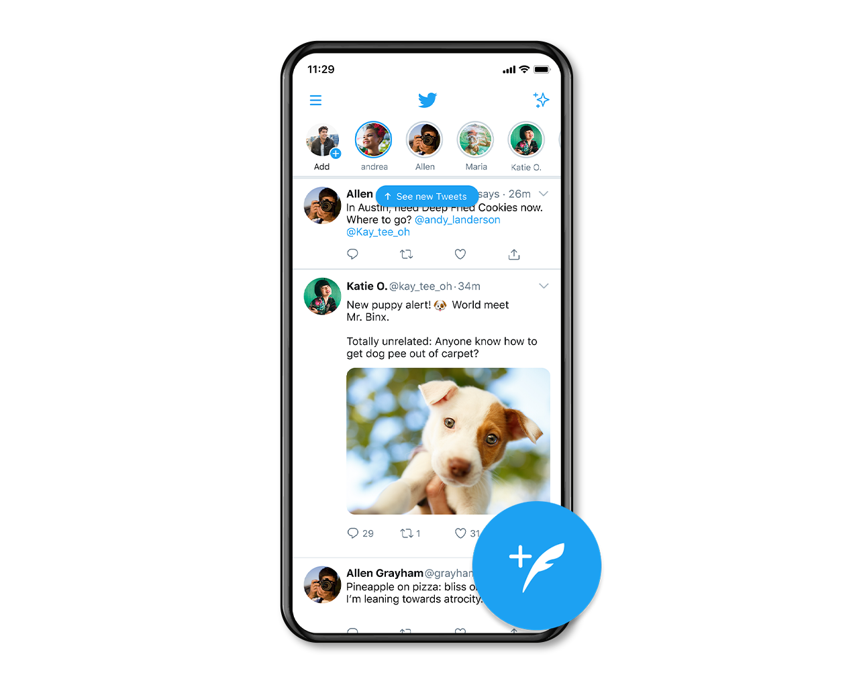

Slide 20
Serialize
Network
Data Model
Data Model
Data Model
Activity
Layout

Slide 21
Serialize
Network
twitt
twitt
twitt
Activity
twitt
twitt
twitt
twitt
twitt
Layout

Slide 22
Data
List<twitt> twitts;
client.newCall(request).enqueue(new Callback<List<twitt>>() { @Override public void onResponse(Call<List<twitt>> call, Response<List<twitt>> response) { if (response.isSuccessful()) { twitts = response.body(); } } @Override public void onFailure(Call<List<twitt>> call, Throwable t) { } });

Slide 23
OkHttpClient client = new OkHttpClient().newBuilder() .build(); MediaType mediaType = MediaType.parse("application/json"); Request request = new Request.Builder() .url("https://api.coingecko.com/api/v3/coins/markets?vs_currency=usd&ids=bitcoin,ethereum") .method("GET", null) .addHeader("accept", "application/json") .build(); client.newCall(request).enqueue(new Callback() { @Override public void onFailure(@NonNull Call call, @NonNull IOException e) { Log.d("Hatalı işlem", "onFailure:"); } @Override public void onResponse(@NonNull Call call, @NonNull Response response) throws IOException { if(response.isSuccessful()) { final String json = response.body().string(); Coin[] CoinList = new Gson().fromJson(json, Coin[].class); Coin coin = CoinList[0]; mainActivity.getCoinNameData(coin.getName()); Log.d("İşlem başarılı", "onResponse: " + coin.getName()); } } });

Slide 24
Data Driven View Architecture
Model
View
Controller
DATA Source
List<twitt> twitts;
UI View
Listview - Recyclerview
<androidx.recyclerview.widget.RecyclerView
android:layout_width="match_parent"
android:layout_height="match_parent"
android:id="@+id/data_list_recyclerView"
app:layout_constraintBottom_toBottomOf="parent"
app:layout_constraintEnd_toEndOf="parent"
app:layout_constraintStart_toStartOf="parent"
app:layout_constraintTop_toTopOf="parent">
</androidx.recyclerview.widget.RecyclerView>
Adapter
new TwittsArrayAdapter(twitts);

Slide 25
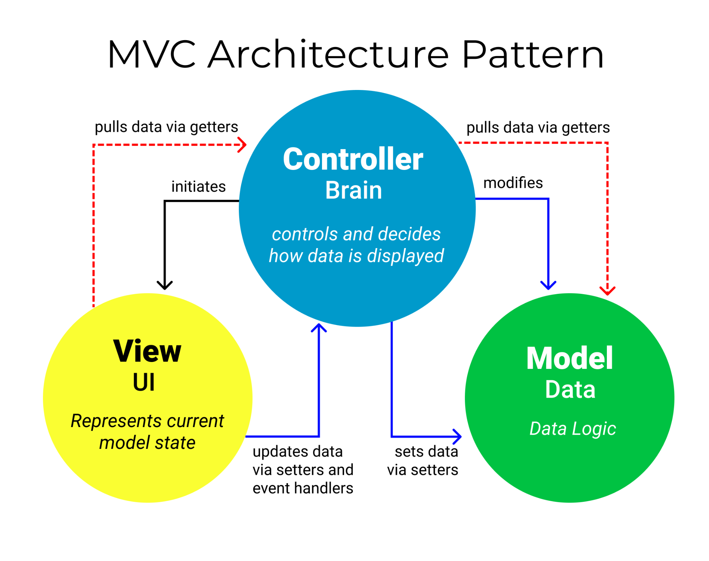
MVC
The MVC architecture pattern turns complex application development into a much more manageable process. It allows several developers to simultaneously work on the application.

Slide 26
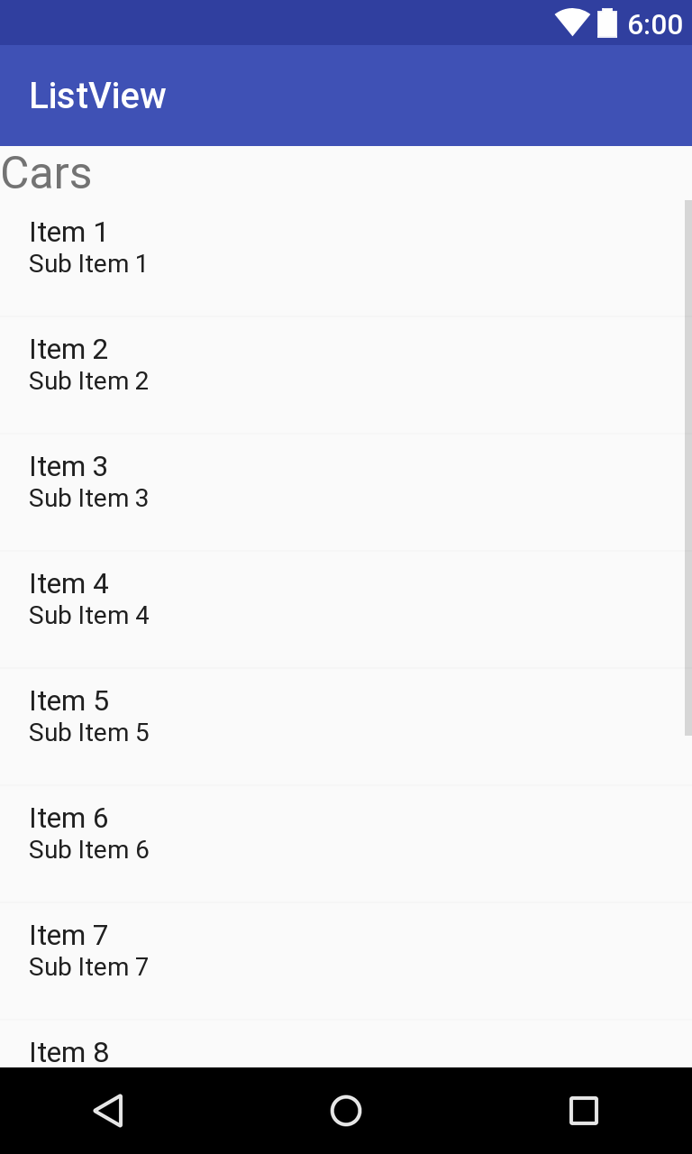
ListView
A ListView is basically a LinearLayout inside of a ScrollView (which is a ViewGroup that can be scrolled). Each element within the LinearLayout is another View (usually a Layout) representing a particular item in a list.
ListView does extra work beyond just nesting Views: it keeps track of what items are already displayed on the screen, inflating only the visible items (plus a few extra on the top and bottom as buffers). Then as the user scrolls, the ListView takes the disappearing views and recycles them (altering their content, but not re-inflating from scratch) in order to reuse them for the new items that appear. This lets it save memory, provide better performance, and overall work more smoothly.
ListView | Android Developers

Slide 27
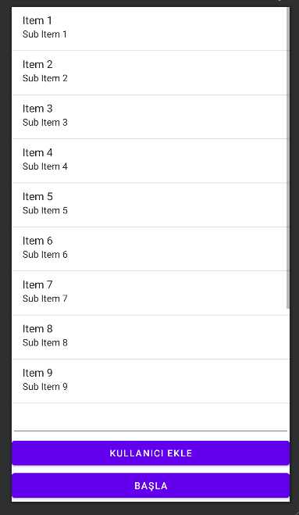
ListView
<ListView android:id="@+id/userList" android:layout_width="match_parent" android:layout_height="match_parent" />

Slide 28
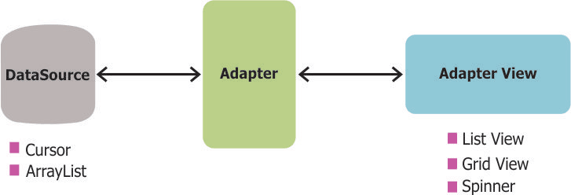
Adapter
Adapters. Adapters in Android | by MDG | MDG Space | Medium.

Slide 29
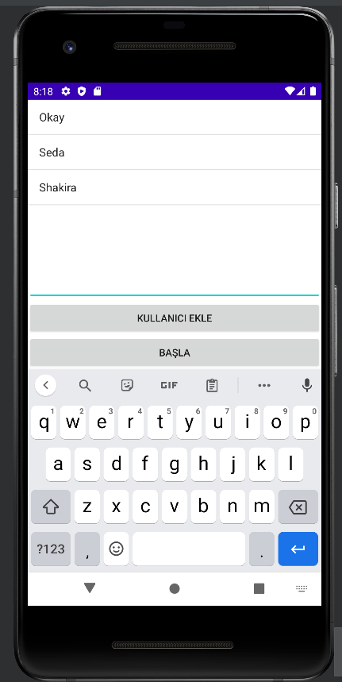
Listview Adapter
ArrayList<String> userListAdapter = new ArrayAdapter<String>(
this, android.R.layout.simple_list_item_1, userListArrayList); userList.setAdapter(userListAdapter);

Slide 30
Listview Adapter
public class calendarAdapter extends ArrayAdapter<calendarItem> { private Context _context; private ArrayList<calendarItem> calendarList; public calendarAdapter(Context context, ArrayList<calendarItem> calendarList) { super(context, R.layout.calendar_item, calendarList); _context = context; this.calendarList = calendarList; } @Override public View getView(final int position, View convertView, ViewGroup parent) { final calendarItem item = getItem(position); if(convertView == null) convertView = LayoutInflater.from(getContext()).inflate(R.layout.calendar_item,parent,false); . . .
ArrayList<calendarItem> clendarList = new ArrayList<calendarItem>(); cAdapter = new calendarAdapter(getBaseContext(),clendarList); calendar_list.setAdapter(cAdapter);

Slide 31
RecyclerView
Create dynamic lists with RecyclerView | Android Developers

Slide 32
RecyclerView components
Data: It doesn't matter where the data comes from. You can create the data locally, as you do in the practical, get it from a database on the device as you will do in a later practical, or pull it from the cloud. A RecyclerView. The scrolling list that contains the list items. An instance of RecyclerView as defined in your activity's layout file to act as the container for the views. Layout for one item of data. All list items look the same, so you can use the same layout for all of them. The item layout has to be created separately from the activity's layout, so that one item view at a time can be created and filled with data. A layout manager. The layout manager handles the organization (layout) of user interface components in a view. All view groups have layout managers. For the LinearLayout, the Android system handles the layout for you. RecyclerView requires an explicit layout manager to manage the arrangement of list items contained within it. This layout could be vertical, horizontal, or a grid. The layout manager is an instance of Recyclerview.LayoutManager to organize the layout of the items in the RecyclerView

Slide 33
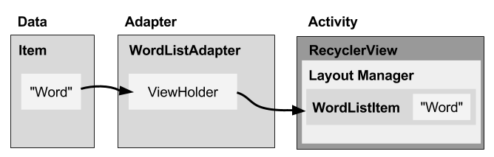
RecyclerView components
An adapter. The adapter connects your data to the RecyclerView. It prepares the data and how will be displayed in a view holder. When the data changes, the adapter updates the contents of the respective list item view in the RecyclerView. And an adapter is an extension of RecyclerView.Adapter. The adapter uses a ViewHolder to hold the views that constitute each item in the RecyclerView, and to bind the data to be displayed into the views that display it. A view holder. The view holder extends the ViewHolder class. It contains the view information for displaying one item from the item's layout. A view holder used by the adapter to supply data, which is an extension of RecyclerView.ViewHolder The diagram below shows the relationship between these compoments.

Slide 34
Data
Any displayable data can be shown in a RecyclerView.
Text
Images
Icons
Data can come from any source.
Created by the app. For example, scrambled words for a game.
From a local database. For example, a list of contacts.
From cloud storage or the internet. For example news headlines.

Slide 35
RecyclerView
A RecyclerView is:
A View group for a scrollable container
Ideal for long lists of similar items
Uses only a limited number of views that are re-used when they go off-screen. This saves memory and makes it faster to update list items as the user scrolls through data, because it is not necessary to create a new view for every item that appears.
In general, the RecyclerView keeps as many item views as fit on the screen, plus a few extra at each end of the list to make sure that scrolling is fast and smooth.

Slide 36
Item Layout
The layout for a list item is kept in a separate file so that the adapter can create item views and edit their contents independently from the layout of the activity.

Slide 37
Layout Manager
A layout manager positions item views inside a view group, such as the RecyclerView and determines when to reuse item views that are no longer visible to the user. To reuse (or recycle) a view, a layout manager may ask the adapter to replace the contents of the view with a different element from the dataset. Recycling views in this manner improves performance by avoiding the creation of unnecessary views or performing expensive findViewById() lookups. RecyclerView provides these built-in layout managers:
LinearLayoutManager shows items in a vertical or horizontal scrolling list.
GridLayoutManager shows items in a grid.
StaggeredGridLayoutManager shows items in a staggered grid.
To create a custom layout manager, extend the RecyclerView.LayoutManager class.
Animations
Animations for adding and removing items are enabled by default in RecyclerView. To customize these animations, extend the RecyclerView.ItemAnimator class and use the RecyclerView.setItemAnimator() method.

Slide 38
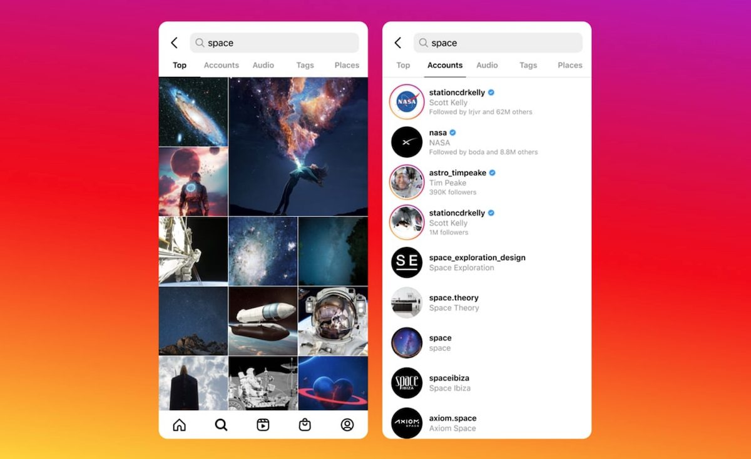
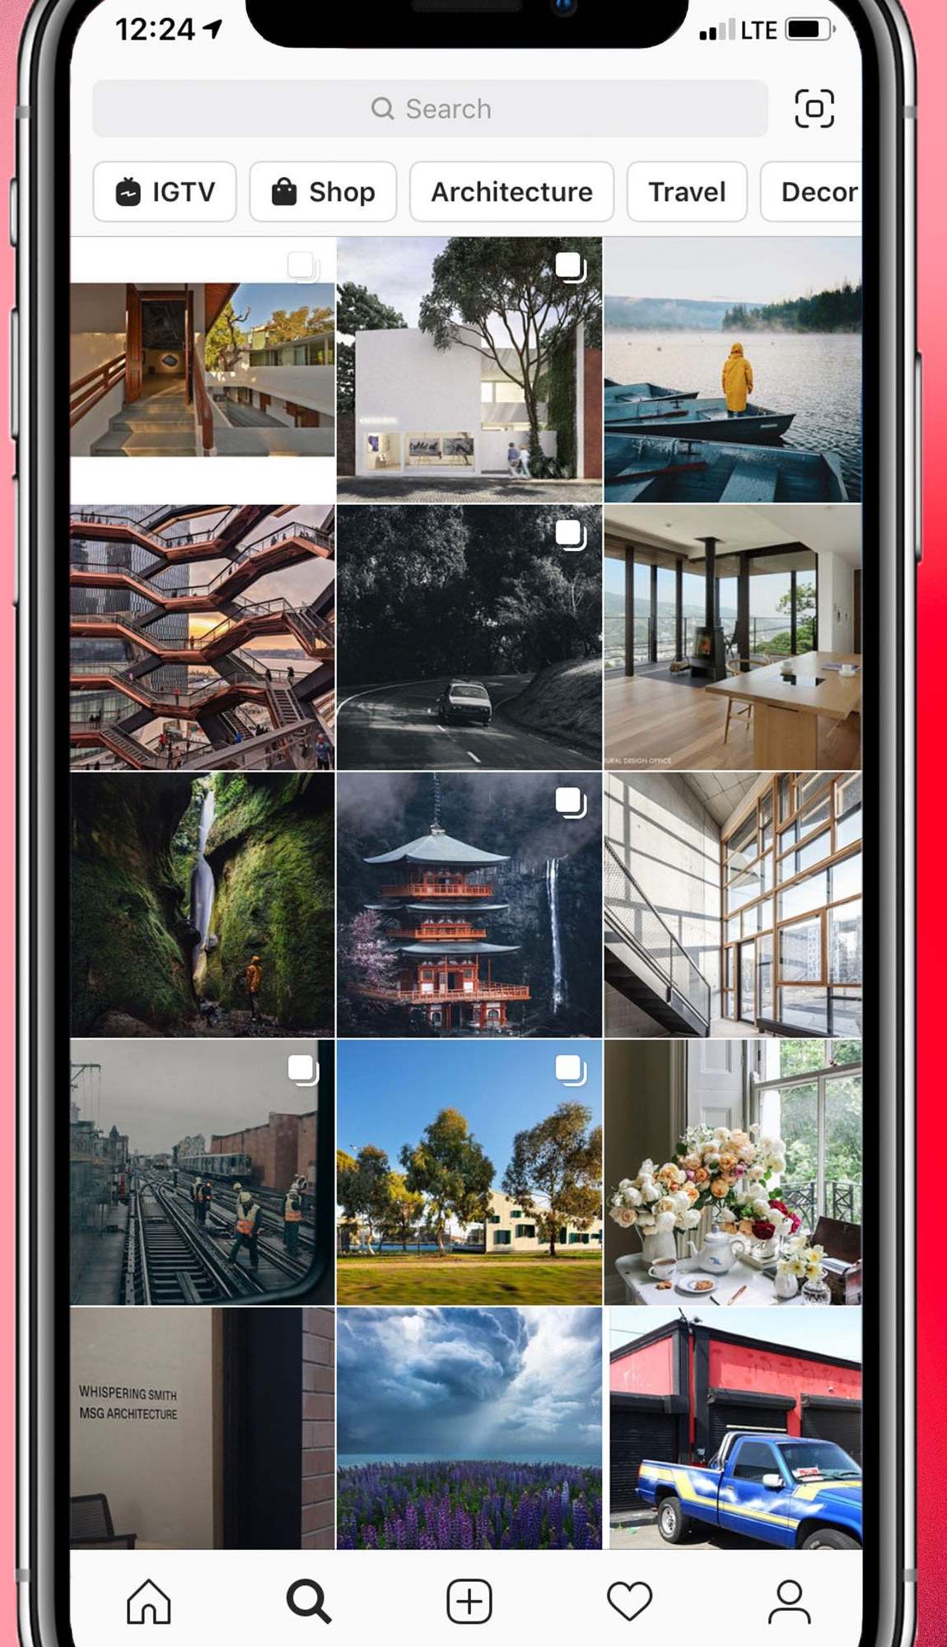
LinearLayoutManager
GridLayoutManager
StaggeredGridLayoutManager

Slide 39
Adapter
An Adapter helps two incompatible interfaces to work together. In the RecyclerView, the adapter connects data with views. It acts as an intermediary between the data and the view. The Adapter receives or retrieves the data, does any work required to make it displayable in a view, and places the data in a view.
The RecyclerView.Adapter implements a view holder, and must override the following callbacks:
onCreateViewHolder() inflates an item view and returns a new view holder that contains it. This method is called when the RecyclerView needs a new view holder to represent and item.
onBindViewHolder() sets the contents of an item at a given position in the RecyclerView. This is called by the RecyclerView, for example, when a new item scrolls into view.
getItemCount() returns the total number of items in the data set held by the adapter.

Slide 40
View holder
A RecyclerView.ViewHolder describes an item view and metadata about its place within the RecyclerView. Each view holder holds one set of data. The adapter adds data to view holders for the layout manager to display.
You define your view holder layout in an XML resource file. It can contain (almost) any type of view, including clickable elements.

Slide 41
Implementing a Recycler View
Add the RecyclerView dependency to the app's app/build.gradle file.
Add the RecyclerView to the activity's layout
Create a layout XML file for one item
Extend RecyclerView.Adapter and implement onCreateViewHolder and onBindViewHolder methods.
Extend RecyclerView.ViewHolder to create a view holder for your item layout. You can add click behavior by overriding the onClick method.
In your activity, In the onCreate method, create a RecyclerView and initialize it with the adapter and a layout manager.

Slide 42
1. Add the dependency to app/build.gradle
Add the recycler view library to your app/build.gradle file as a dependency. Look at the chapter on support libraries or the RecyclerView practical, if you need detailed instructions.
dependencies {
...
compile 'com.android.support:recyclerview-v7:24.1.1'
...
}

Slide 43
2. Add a RecyclerView to your activity's layout
Add the RecyclerView in your activity's layout file.
<android.support.v7.widget.RecyclerView android:id="@+id/recyclerview" android:layout_width="match_parent" android:layout_height="match_parent"> </android.support.v7.widget.RecyclerView>
Use the recycler view from the support library to be compatible with older devices. The only required attributes are the id, along with the width and height. Customize the items, not this view group.
androidx.recyclerview.widget.RecyclerView
android.support.v7.widget.RecyclerView

Slide 44
3. Create the layout for one item
Create an XML resource file and specify the layout of one item. This will be used by the adapter to create the view holder. <LinearLayout xmlns:android="http://schemas.android.com/apk/res/android" android:layout_width="match_parent" android:layout_height="wrap_content" android:orientation="vertical" android:padding="6dp">
<TextView android:id="@+id/word" style="@style/word_title" />
</LinearLayout>
The text view has a @style element. A style is a collection of properties that specifies the look of a view. You can use styles to share display attributes with multiple views. An easy way to create a style is to extract the style of a UI element that you already created. For example, after styling a TextView, Right-click > Refactor > Extract > Style on the element and follow the dialog prompts.

Slide 45
4. Create an adapter with a view holder
Extend RecyclerView.Adapter and implement the onCrateViewHolder and onBindViewHolder methods. Create a new Java class with the following signature: public class WordListAdapter extends RecyclerView.Adapter<WordListAdapter.WordViewHolder> {} In the constructor, get an inflater from the current contex, and your data.
public WordListAdapter(Context context, LinkedList<String> wordList) {
mInflater = LayoutInflater.from(context);
this.mWordList = wordList;
}

Slide 46
4. Create an adapter (implement Methods)
onCreateViewHolder() creates a view and returns it. @Override public WordViewHolder onCreateViewHolder(ViewGroup parent, int viewType){ // Inflate an item view. View mItemView = mInflater.inflate(R.layout.wordlist_item, parent, false); return new WordViewHolder(mItemView, this); } onBindViewHolder() associates the data with the view holder for a given position in the RecyclerView. @Override public void onBindViewHolder(WordViewHolder holder, int position) { // Retrieve the data for that position String mCurrent = mWordList.get(position); // Add the data to the view holder.wordItemView.setText(mCurrent); }
getItemCount() returns to number of data items available for displaying. @Override public int getItemCount() { return mWordList.size(); }

Slide 47
5. Implement the view holder class
Extend RecyclerView.ViewHolder to create a view holder for your item layout. You can add click behavior by overriding the onClick method. This class is usually defined as an inner class to the adapter and extends RecyclerView.ViewHolder. class WordViewHolder extends RecyclerView.ViewHolder {} If you want to add click handling, you need to implement a click listener. One way to do this is to have the view holder implement the click listener methods. // Extend the signature of WordVewHolder to implement a click listener. class WordViewHolder extends RecyclerView.ViewHolder implements View.OnClickListener {} In its constructor, the view holder has to inflate its layout, associate with its adapter, and, if applicable, set a click listener. public WordViewHolder(View itemView, WordListAdapter adapter) { super(itemView); wordItemView = (TextView) itemView.findViewById(R.id.word); this.mAdapter = adapter; itemView.setOnClickListener(this); }

Slide 48
5. Implement the view holder class (onClickListener)
@Override
public void onClick(View v) {
wordItemView.setText ("Clicked! "+ wordItemView.getText());
}
Note that to attach click listeners to other elements of the view holder, you do that dynamically in onBindViewHolder. (You will do this a later practical, when you will be extending the recycler view code from the practical.)

Slide 49
6. Create the RecyclerView
Finally, to tie it all together, in your activity's onCreate() method:
Get a handle to the RecyclerView.
mRecyclerView = (RecyclerView) findViewById(R.id.recyclerview);
Create an adapter and supply the data to be displayed.
mAdapter = new WordListAdapter(this, mWordList);
Connect the adapter with the recycler view.
mRecyclerView.setAdapter(mAdapter);
Give the recycler view a default layout manager.
mRecyclerView.setLayoutManager(new LinearLayoutManager(this));
RecyclerView is an efficient way for displaying scrolling list data. It uses the adapter pattern to connect data with list item views. To implement a RecyclerView you need to create an adapter and a view holder, and the methods that take the data and add it to the list items.

Slide 50
Sample Code

Slide 51
Add the RecyclerView to the activity's layout
<?xml version="1.0" encoding="utf-8"?> <androidx.constraintlayout.widget.ConstraintLayout xmlns:android="http://schemas.android.com/apk/res/android" xmlns:app="http://schemas.android.com/apk/res-auto" xmlns:tools="http://schemas.android.com/tools" android:layout_width="match_parent" android:layout_height="match_parent" tools:context=".Activities.DataDisplayActivity"> <androidx.recyclerview.widget.RecyclerView android:layout_width="match_parent" android:layout_height="match_parent" android:id="@+id/data_list_recyclerView" app:layout_constraintBottom_toBottomOf="parent" app:layout_constraintEnd_toEndOf="parent" app:layout_constraintStart_toStartOf="parent" app:layout_constraintTop_toTopOf="parent"> </androidx.recyclerview.widget.RecyclerView>
</androidx.constraintlayout.widget.ConstraintLayout>

Slide 52
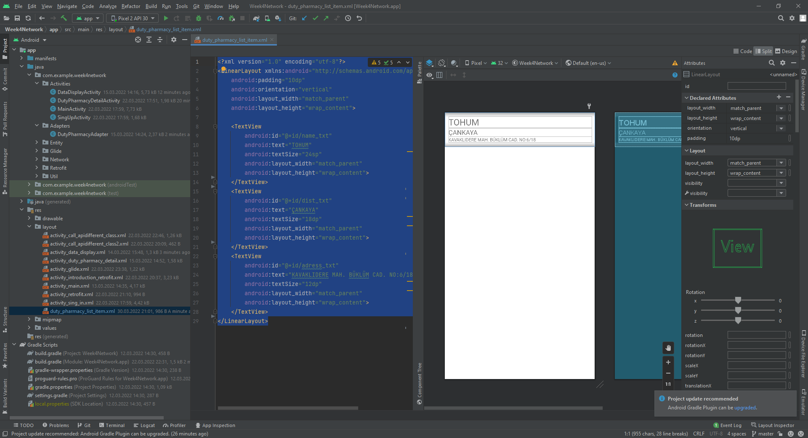
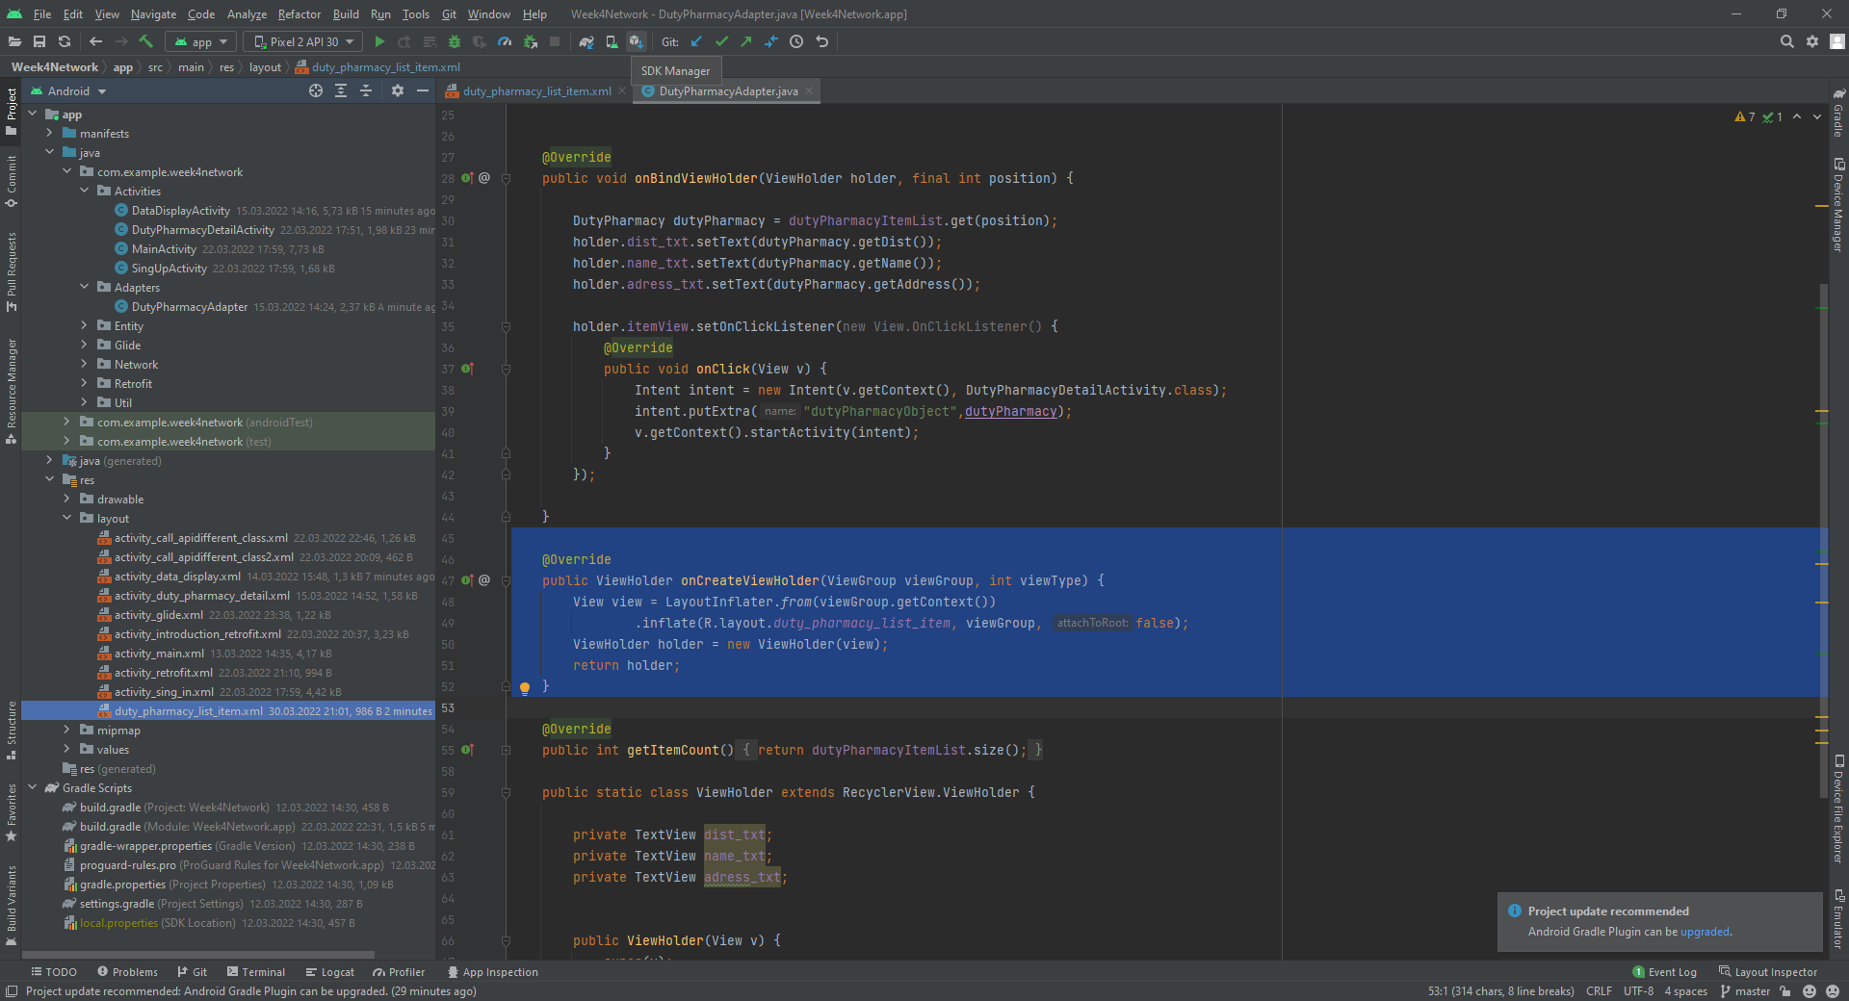
Create a layout XML file for one item
<?xml version="1.0" encoding="utf-8"?> <LinearLayout xmlns:android="http://schemas.android.com/apk/res/android" android:padding="10dp" android:orientation="vertical" android:layout_width="match_parent" android:layout_height="wrap_content"> <TextView android:id="@+id/name_txt" android:textSize="24sp" android:layout_width="match_parent" android:layout_height="wrap_content"> </TextView> <TextView android:id="@+id/dist_txt" android:textSize="18sp" android:layout_width="match_parent" android:layout_height="wrap_content"> </TextView> <TextView android:id="@+id/adress_txt" android:textSize="12sp" android:layout_width="match_parent" android:layout_height="wrap_content"> </TextView> </LinearLayout>

Slide 53
Extend RecyclerView.Adapter and implement onCrateViewHolder and onBindViewHolder methods
public class DutyPharmacyAdapter extends RecyclerView.Adapter<DutyPharmacyAdapter.ViewHolder> {
private ArrayList<DutyPharmacy> dutyPharmacyItemList;
public DutyPharmacyAdapter( ArrayList<DutyPharmacy> dutyPharmacyItemList) {
this.dutyPharmacyItemList = dutyPharmacyItemList;
}

Slide 54
Extend RecyclerView.Adapter and implement onCrateViewHolder and onBindViewHolder methods
@Override
public ViewHolder onCreateViewHolder(ViewGroup viewGroup, int viewType) {
View view = LayoutInflater.from(viewGroup.getContext())
.inflate(R.layout.duty_pharmacy_list_item, viewGroup, false);
ViewHolder holder = new ViewHolder(view);
return holder;
}

Slide 55
Extend RecyclerView.Adapter and implement onCrateViewHolder and onBindViewHolder methods
@Override public void onBindViewHolder(ViewHolder holder, final int position) { DutyPharmacy dutyPharmacy = dutyPharmacyItemList.get(position); holder.dist_txt.setText(dutyPharmacy.getDist()); holder.name_txt.setText(dutyPharmacy.getName()); holder.adress_txt.setText(dutyPharmacy.getAddress()); holder.itemView.setOnClickListener(new View.OnClickListener() { @Override public void onClick(View v) { Intent intent = new Intent(v.getContext(), DutyPharmacyDetailActivity.class); intent.putExtra("dutyPharmacyObject",dutyPharmacy); v.getContext().startActivity(intent); }
});
}

Slide 56
Extend RecyclerView.Adapter and implement onCrateViewHolder and onBindViewHolder methods
@Override
public int getItemCount() {
return dutyPharmacyItemList.size();
}

Slide 57
Implement the view holder class
public static class ViewHolder extends RecyclerView.ViewHolder { private TextView dist_txt; private TextView name_txt; private TextView adress_txt;
public ViewHolder(View v) { super(v); dist_txt = v.findViewById(R.id.dist_txt); name_txt = v.findViewById(R.id.name_txt); adress_txt = v.findViewById(R.id.adress_txt); } }

Slide 58
Create a layout XML file for one item
<?xml version="1.0" encoding="utf-8"?> <LinearLayout xmlns:android="http://schemas.android.com/apk/res/android" android:padding="10dp" android:orientation="vertical" android:layout_width="match_parent" android:layout_height="wrap_content"> <TextView android:id="@+id/name_txt" android:textSize="24sp" android:layout_width="match_parent" android:layout_height="wrap_content"> </TextView> <TextView android:id="@+id/dist_txt" android:textSize="18dp" android:layout_width="match_parent" android:layout_height="wrap_content"> </TextView> <TextView android:id="@+id/adress_txt" android:textSize="12dp" android:layout_width="match_parent" android:layout_height="wrap_content"> </TextView> </LinearLayout>

Slide 59
Create the RecyclerView
DutyPharmacyAdapter adapter = new DutyPharmacyAdapter(dutyPharmacyItemList);
RecyclerView.LayoutManager mLayoutManager = new LinearLayoutManager(getApplicationContext());
activityDataDisplayBinding.dataListRecyclerView.setLayoutManager(mLayoutManager);
activityDataDisplayBinding.dataListRecyclerView.setAdapter(adapter);

Slide 60
Data?
@Override public void onResponse(@NonNull Call call, @NonNull Response response) throws IOException { if(response.isSuccessful()) { final String myResponse = response.body().string(); dutyPharmacyItemList = new ArrayList<DutyPharmacy>(); DutyPharmacy[] DutyPharmacyList = new Gson().fromJson(myResponse, DutyPharmacy[].class); dutyPharmacyItemList = new ArrayList<DutyPharmacy>(Arrays.asList(DutyPharmacyList)); DataDisplayActivity.this.runOnUiThread(new Runnable() { @Override public void run() { hideProgressbar(); diplayListData(); } }); } }

